Slide 1

Memory Management in C and C++

Slide 2
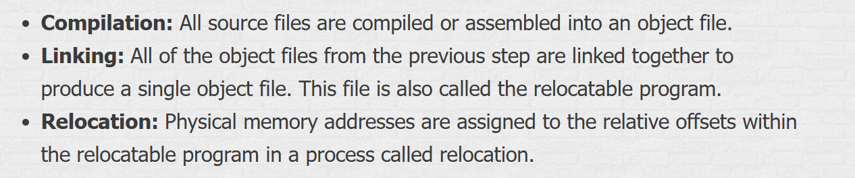
What happen during the execution process of C/C++ Program
.c and cpp files can’t be executed directly and has to go through a series of steps. The main thing that happens during the execution process of a C/C++ Program is the conversion of the high-level source code into an executable binary file.

Slide 3
Memory Management in C and C++
Memory management involves allocating and deallocating memory during the execution of a program. In C and C++, this is done both at compile time (static memory allocation) and at runtime (dynamic memory allocation).
Memory management in C and C++ is a crucial concept, especially for beginners. Let's break it down into simpler terms and use examples to make it more understandable.

Slide 4
Different memory regions in C++
Understanding these regions will give you a clearer picture of how memory management works in C++.
Static region,
Stack (static frame),
Heap memory.
Memory management in C and C++ is a crucial concept, especially for beginners. Let's break it down into simpler terms and use examples to make it more understandable.

Slide 5
How It Works
Compile Time (Static Allocation):
The compiler determines the amount of memory needed.
Memory is allocated on the stack.
The lifetime of this memory is limited to the scope in which it is defined.
Run Time (Dynamic Allocation):
Memory is allocated on the heap.
The programmer must manually manage this memory (allocate and deallocate).
The lifetime of this memory is until it is explicitly deallocated.
.

Slide 6
Static Region
#include <iostream>
int globalVar = 10; // Global variable
void func()
{
static int staticVar = 20; // Static variable
std::cout << "Static Variable: " << staticVar << std::endl;
}
int main() {
std::cout << "Global Variable: " << globalVar << std::endl;
func();
return 0;
}
The static region is used for variables that have a static or global scope. These variables are allocated memory at compile time and remain in memory for the entire duration of the program.
Characteristics:
Lifetime: Entire duration of the program.
Scope: Global or static within a function.
Memory Location: Static region.
Static memory allocation happens at compile time. The size of the memory required is known before the program runs. This type of memory is allocated on the stack.
Static region stores static variables that remain in use throughout the execution of a program. The size of the static region does not change during the C++ program’s execution.

Slide 7
Stack (Static Frame)
#include <iostream>
void func()
{
int localVar = 30; // Local variable
std::cout << "Local Variable: " << localVar << std::endl;
}
int main() {
func();
return 0;
}
The stack is used for local variables and function call management. Memory is allocated and deallocated automatically when functions are called and return.
Characteristics:
Lifetime: Limited to the scope of the function or block.
Scope: Local to the function or block.
Memory Location: Stack.
localVar is stored on the stack. When func is called, localVar is allocated memory on the stack, and when func returns, the memory is automatically deallocated.
Stack stores stack frames, and a new stack frame is created for every function call.

Slide 8
Heap Memory
The heap is used for dynamic memory allocation. Memory is allocated and deallocated manually by the programmer using new and delete.
Characteristics:
Lifetime: Until explicitly deallocated.
Scope: Accessible through pointers.
Memory Location: Heap.
#include <iostream>
int main() {
int *ptr = new int; // Dynamic memory allocation
*ptr = 40;
std::cout << "Heap Variable: " << *ptr << std::endl;
delete ptr; // Deallocating memory
return 0;
}
Dynamic memory allocation happens at runtime. The size of the memory required is determined during the execution of the program. This type of memory is allocated on the heap.
Notes:
Example in C:
#include <stdio.h>
#include <stdlib.h>
int main() {
int *ptr;
ptr = (int *)malloc(sizeof(int)); // Dynamic memory allocation
if (ptr == NULL) {
printf("Memory allocation failed\n");
return 1;
}
*ptr = 20;
printf("Value of *ptr: %d\n", *ptr);
free(ptr); // Deallocating memory
return 0;
}
Example in C++:
#include <iostream>
int main() {
int *ptr = new int; // Dynamic memory allocation
*ptr = 30;
std::cout << "Value of *ptr: " << *ptr << std::endl;
delete ptr; // Deallocating memory
return 0;
}
In these examples, memory is allocated dynamically using malloc in C and new in C++. The allocated memory is then freed using free in C and delete in C++.

Slide 9
Memory Management
Understanding these memory regions helps you write more efficient and error-free programs.
Static Region: Stores global and static variables. Memory is allocated at compile time and remains for the program's lifetime.
Stack: Stores local variables and function call information. Memory is automatically managed and has a limited lifetime.
Heap: Used for dynamic memory allocation. Memory is manually managed and has a flexible lifetime.

Slide 10
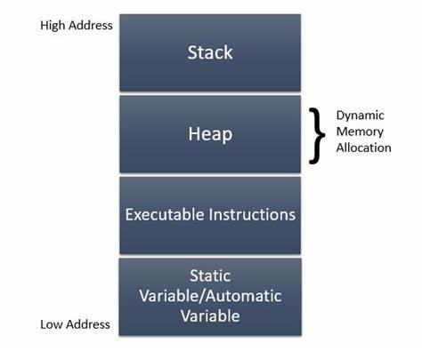
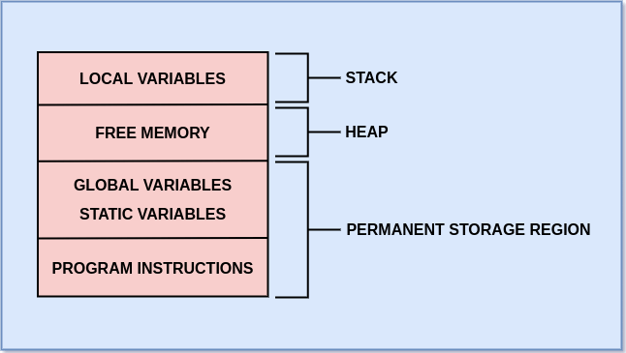
Memory Management in C and C++

Slide 11
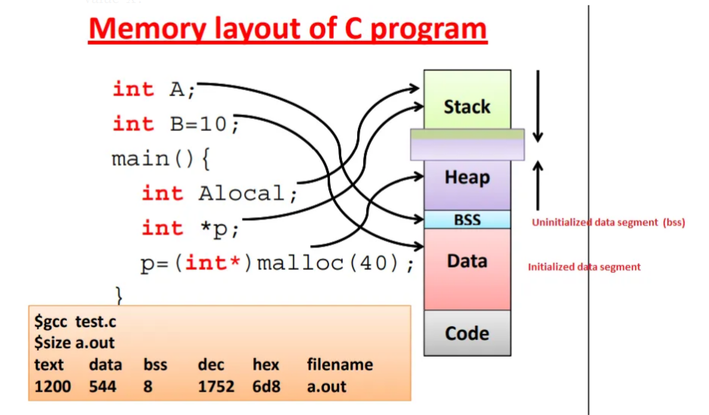

Slide 12
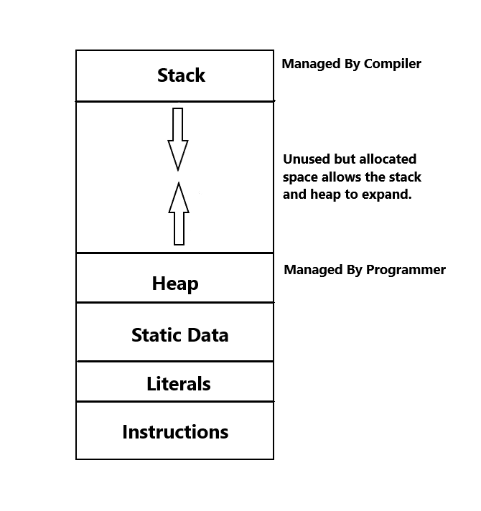

Slide 13
#include <stdio.h>
#include <stdlib.h>
int main() {
int *ptr;
ptr = (int *)malloc(sizeof(int)); // Dynamic memory allocation
if (ptr == NULL) {
printf("Memory allocation failed\n");
return 1;
}
*ptr = 20;
printf("Value of *ptr: %d\n", *ptr);
free(ptr); // Deallocating memory
return 0;
}
#include <iostream>
int main() {
int *ptr = new int; // Dynamic memory allocation
*ptr = 30;
std::cout << "Value of *ptr: " << *ptr << std::endl;
delete ptr; // Deallocating memory
return 0;
}
Memory is allocated dynamically using malloc in C and new in C++. The allocated memory is then freed using free in C and delete in C++.

Slide 14
#include<stdio.h>
void fun();
void fun() //stack memory allocation(runtime)
{
int a=10,b=5,c;
c=a+b
print("Result: %d",c)
}
int main() //static memory allocation (Compiling)
{
int x=100,y=55,ans;
ans=x-y;
printf("Difference :%d",ans);
fun();
printf("End");
printf("Bye");
}

Slide 15
How It Works
Compile Time (Static Allocation):
The compiler determines the amount of memory needed.
Memory is allocated on the stack.
The lifetime of this memory is limited to the scope in which it is defined.
Run Time (Dynamic Allocation):
Memory is allocated on the heap.
The programmer must manually manage this memory (allocate and deallocate).
The lifetime of this memory is until it is explicitly deallocated.
Key Points to Remember
Stack Memory: Fast access, limited size, automatically managed.
Heap Memory: Larger size, slower access, manually managed.

